Slide 1
SPARK MLIB

Slide 2
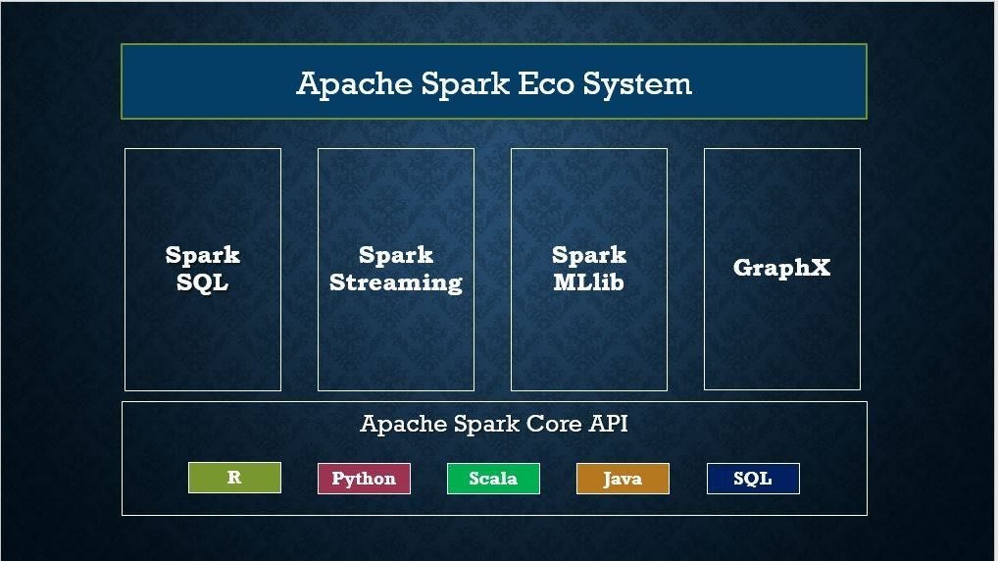

Slide 3
Apache Spark MLlib is a machine learning library designed for scalability and ease of use within the Spark ecosystem.
Spark MLlib is a module on top of Spark Core that provides machine learning primitives as APIs..
It provides a comprehensive set of tools and algorithms for various machine learning tasks.

Slide 4
Key ML Components in Databricks
1. Databricks Machine Learning (ML) Runtime
Pre-installed with popular ML libraries (e.g., TensorFlow, PyTorch, scikit-learn, XGBoost).
GPU-accelerated for deep learning workloads.
Includes MLflow for experiment tracking.
2. MLflow (Integrated Open-Source Platform)
Tracking: Log experiments, parameters, metrics, and artifacts.
Projects: Package and reproduce ML code.
Models: Standardized model packaging and deployment.
Model Registry: Centralized model lifecycle management.
3. Databricks AutoML
Automates model training for classification & regression.
Generates Python notebooks with best-performing models (XGBoost, LightGBM, etc.).
Includes feature importance and visualizations.
4. Feature Store
Centralized repository for ML features.
Ensures consistency between training & inference.
Supports time-travel (point-in-time feature lookups).

Slide 5
5. Distributed ML with Spark MLlib
Scalable ML algorithms (classification, regression, clustering).
Works with Spark DataFrames for big data processing.
6. Hyperopt + Spark for Hyperparameter Tuning
Distributed hyperparameter optimization using Bayesian methods.
Integrates with MLflow for tracking trials.
7. Deep Learning Support
GPU clusters for training deep neural networks.
Integration with Horovod (distributed deep learning).
Native support for TensorFlow, PyTorch, and Keras.
8. Model Serving (Databricks Model Serving)
Low-latency REST API endpoints for deployed models.
Supports A/B testing and canary deployments.
9. Databricks Notebooks & Collaboration
Interactive notebooks (Python, R, SQL, Scala) for ML development.
Real-time collaboration with team members.
10. Delta Lake Integration
Reliable, ACID-compliant data storage for ML pipelines.
Supports schema enforcement and time travel for reproducibility.
11. Unity Catalog (Governance & Discovery)
Centralized model and feature lineage tracking.
Access control for ML assets.

Slide 6
Spark MLlib Components
Algorithms:
  Classification: Logistic regression, decision trees, random forests, Naive Bayes
  Regression: Linear regression, generalized linear regression
  Clustering: K-means, Gaussian mixture, LDA
  Collaborative filtering: Alternating least squares (ALS)
Feature Engineering:
  Feature extraction: TF-IDF, Word2Vec, CountVectorizer
  Feature transformation: Tokenizer, StopWordsRemover, n-gram
  Feature selection: ChiSqSelector, VectorSlicer
  Dimensionality reduction: PCA, SVD
Pipelines:
  DataFrame-based API for building ML workflows
  Pipeline stages (Transformers and Estimators)
  Parameter tuning tools
Utilities:
  Linear algebra operations (distributed matrices)
  Statistics functionality (hypothesis testing, correlations)
  Model evaluation tools

Slide 7
BUILD ML MODELS

Slide 8
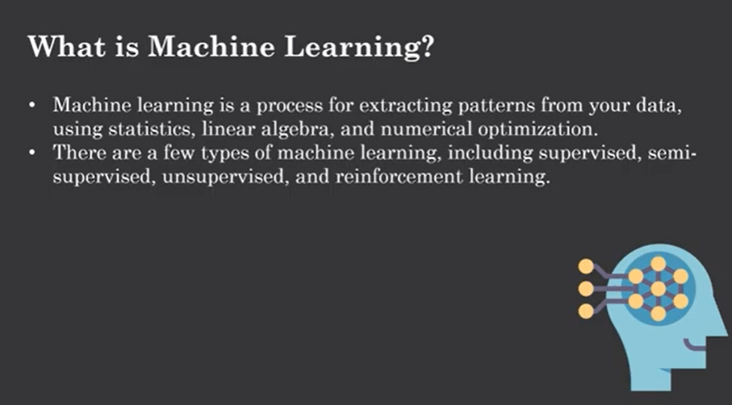

Slide 9
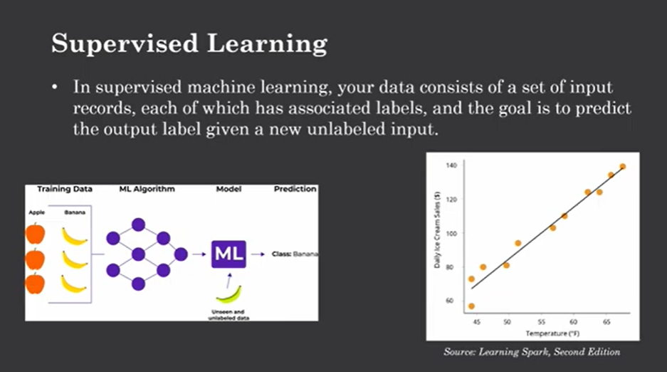

Slide 10
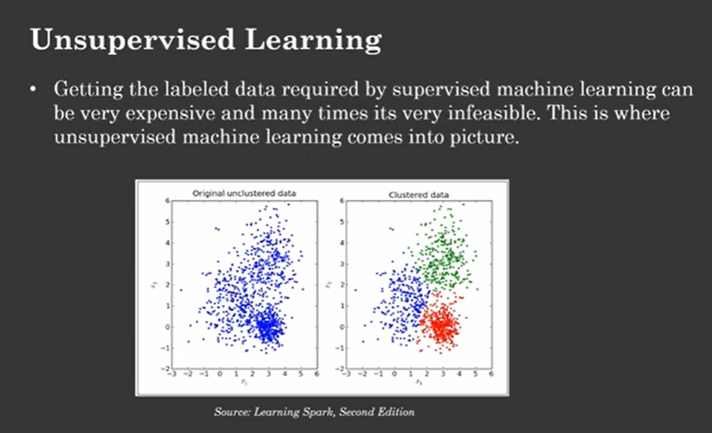

Slide 11
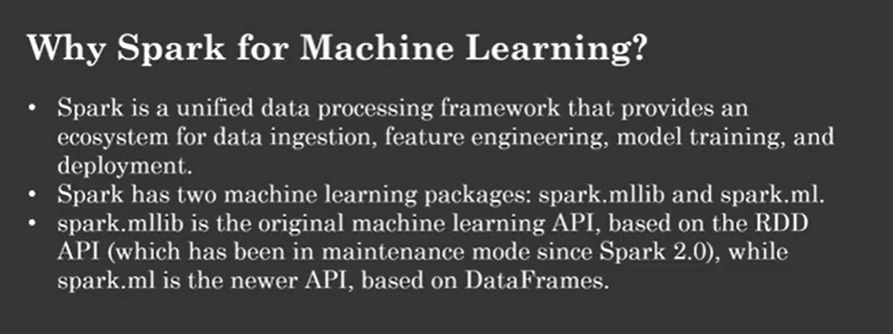

Slide 12
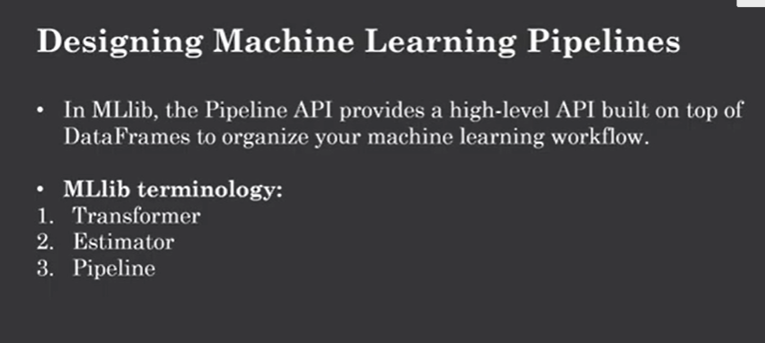

Slide 13
Transformer:
A Transformer is an algorithm that can transform one DataFrame into another DataFrame. Technically, a Transformer implements a method transform(), which converts one DataFrame into another,
An Estimator is an algorithm which can be fit on a DataFrame to produce a Transformer.
Technically, an Estimator implements a method fit(), which accepts a DataFrame and produces
Model, which is a Transformer. For example, a learning algorithm such as Logistic regression is an Estimator, and calling fit() trains a LogisticRegressionModel, which is a Model and hence a Transformer.
Transformer.transform() and Estimator.fit() are both stateless. In the future, stateful algorithms may be supported via alternative concepts.

Slide 14
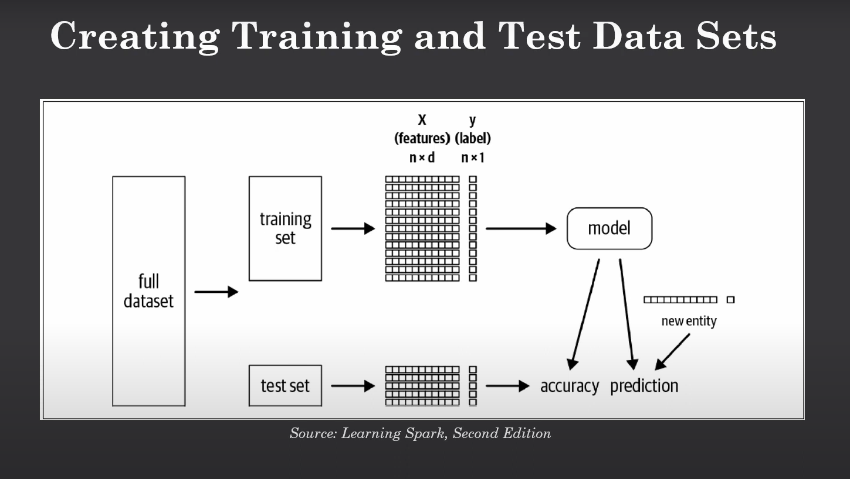

Slide 15
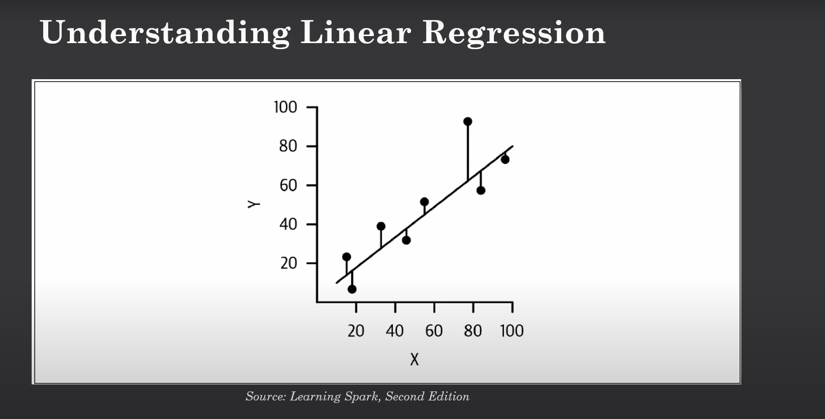

Slide 16
Linear regression is a statistical method used to model the relationship between a dependent variable and one or more independent variables by fitting a linear equation to the observed data

Slide 17
What is Logistic Regression?
Logistic Regression is a classification algorithm (not regression despite the name).
It is used to predict categorical outcomes:
Binary classification → Yes/No, Pass/Fail, Survived/Not Survived.
Multiclass classification → Iris dataset (Setosa, Versicolor, Virginica).
It models the probability of a label using the logistic (sigmoid) function.

Slide 18
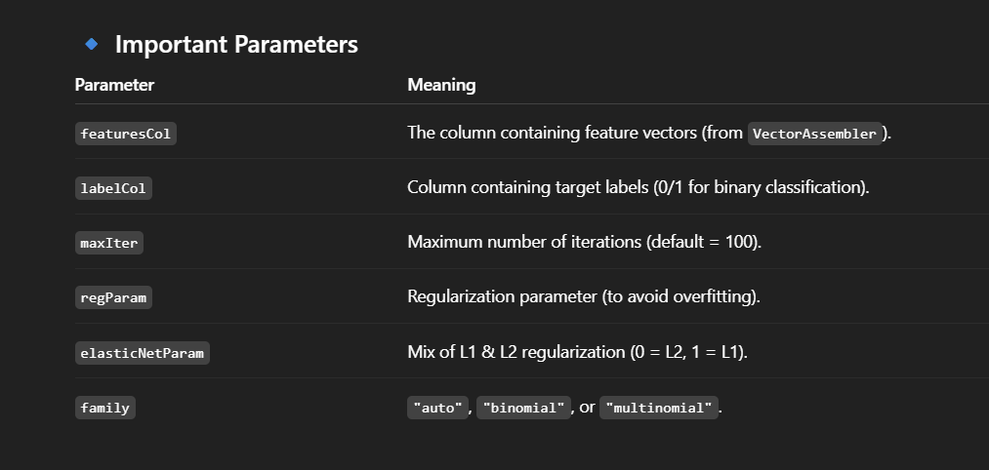

Slide 19
create ,evaluate ,tune ml models using pyspark using student dataframe
Creating a model (Logistic Regression for pass/fail prediction)
Evaluating the model (accuracy, precision, recall, etc.)
Hyperparameter tuning using CrossValidator and ParamGridBuilder

Slide 20
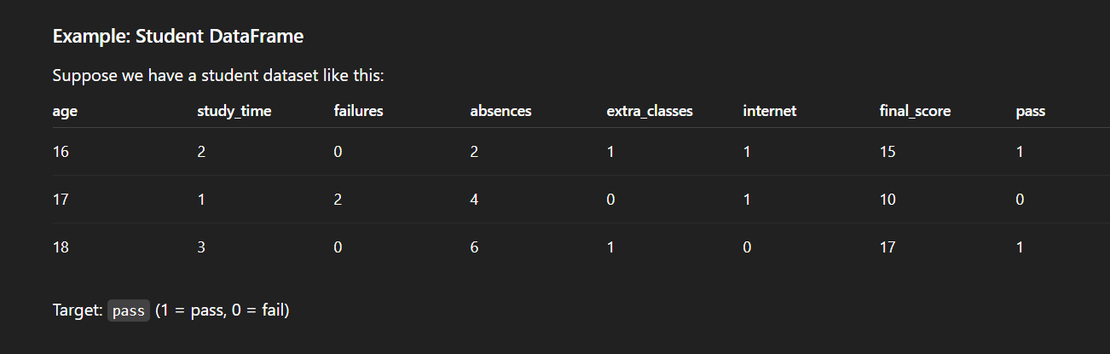

Slide 21
BinaryClassificationEvaluator
In PySpark MLlib,
🔑 BinaryClassificationEvaluator
It is an evaluator class used to measure the performance of binary classification models (where the label is 0 or 1, e.g., pass/fail, churn/not churn, fraud/not fraud).

Slide 22
CrossValidator
🔑 CrossValidator in PySpark
The CrossValidator is a tool in PySpark MLlib that helps you automatically select the best model by:
Training your model multiple times with different hyperparameters (from a ParamGrid).
Splitting the training data into k folds (default k=3).
Training on k-1 folds and validating on the remaining 1 fold.
Repeating this for all folds.
Picking the best hyperparameter combination based on an Evaluator metric (e.g., accuracy, AUC).

Slide 23
Evaluator metric - 🔑 areaUnderROC (AUC-ROC)
🔑 areaUnderROC (AUC-ROC)
areaUnderROC = Area Under the Receiver Operating Characteristic Curve
It measures how well a binary classifier (0/1 prediction) can separate the two classes.

Slide 24
AUC Value | Interpretation
1.0 | Perfect classifier
0.9 – 1.0 | Excellent model
0.8 – 0.9 | Good model
0.7 – 0.8 | Acceptable
0.5 | Random guessing (no predictive power)
< 0.5 | Worse than random

Slide 25
ROC Curve (Receiver Operating Characteristic)
The ROC Curve is a graphical tool used to evaluate the performance of a binary classifier (predicting 0/1).
📌 ROC Curve Interpretation
Perfect Model → Curve goes up and left (TPR=1, FPR=0).
Random Model → Diagonal line (AUC = 0.5).
Better Models → ROC curve bows toward the top-left corner.
📌 AUC (Area Under ROC Curve)
AUC = 1.0 → Perfect classifier
AUC = 0.5 → No discrimination (random guessing)
AUC < 0.5 → Model is predicting opposite (worse than random)

Slide 26
ParamGrid
In PySpark MLlib, a Parameter Grid (ParamGrid) is a way to define different sets of hyperparameters that you want the model to try during training, especially when you are doing Cross Validation (CV) or Train-Validation Split.
Machine learning models (like Logistic Regression, Random Forest, Gradient Boosted Trees, etc.) have hyperparameters (e.g., learning rate, max depth, regularization strength).
These are not learned from the data
We need to choose them manually or tune them automatically
Instead of testing hyperparameters one by one, we create a grid of combinations and let Spark try them all (with cross-validation).

Slide 27
regParam
In PySpark MLlib Logistic Regression (and other linear models like LinearRegression),
🔑 regParam = Regularization Parameter (λ)
It controls how much penalty is added to the model weights to avoid overfitting.
⚡ Why Regularization?
Without regularization → model may fit noise in training data, leading to poor generalization.
With regularization → model keeps weights smaller (simpler model), improving generalization.

Slide 28
regParam
📌 How it works
Higher regParam → stronger penalty on large coefficients
Lower regParam → weaker penalty, model fits more freely
⚖️ Effect of regParam values
regParam = 0.0 → No regularization (pure logistic regression, might overfit).
Small regParam (0.01, 0.1) → Mild penalty, usually good balance.
Large regParam (1.0, 10.0) → Strong penalty, coefficients shrink toward zero (model may underfit).

Slide 29
ElasticNetParam
In PySpark MLlib (LogisticRegression, LinearRegression, etc.),
🔑 elasticNetParam = Mix ratio between L1 and L2 regularization
It decides which type of regularization is applied when you use the regParam penalty.

Slide 30
📌 Types of Regularization
L1 Regularization (Lasso)
Forces some coefficients exactly to zero
Good for feature selection
Controlled when elasticNetParam = 1.0
L2 Regularization (Ridge)
Shrinks coefficients smoothly toward zero, but never exactly zero
Good for preventing overfitting
Controlled when elasticNetParam = 0.0

Slide 31
📌 Types of Regularization
Elastic Net (Mix of L1 + L2)
Combines benefits of both Lasso and Ridge
Used when elasticNetParam is between 0 and 1
Example: elasticNetParam = 0.5 → 50% L1 + 50% L2

Slide 32
📌 How it works with regParam
regParam = strength of penalty
elasticNetParam = type of penalty

